Slide 1
Cognitive Functions and the Organization of the Cerebral Cortex
By: Nicole Phillps

Slide 2
Learning Objectives
Describe general properties of organization in the cerebral cortex
Identify and describe functional areas of importance in the frontal, temporal, and parietal lobes.
Identify and describe symptoms of cortical damage.

Slide 3
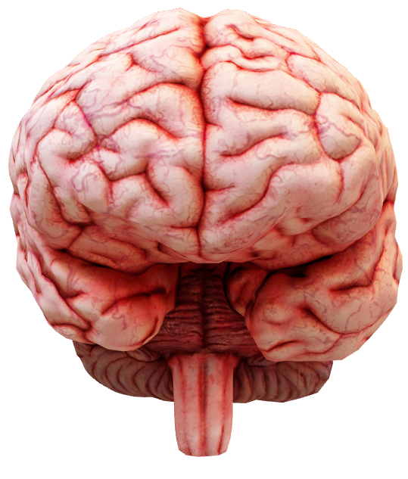
Cerebral Cortex
Part of the forebrain
Collection of mostly gray matter
Folded (gyrencephalized) into gyri (hills) & sulci (valleys)

Slide 4
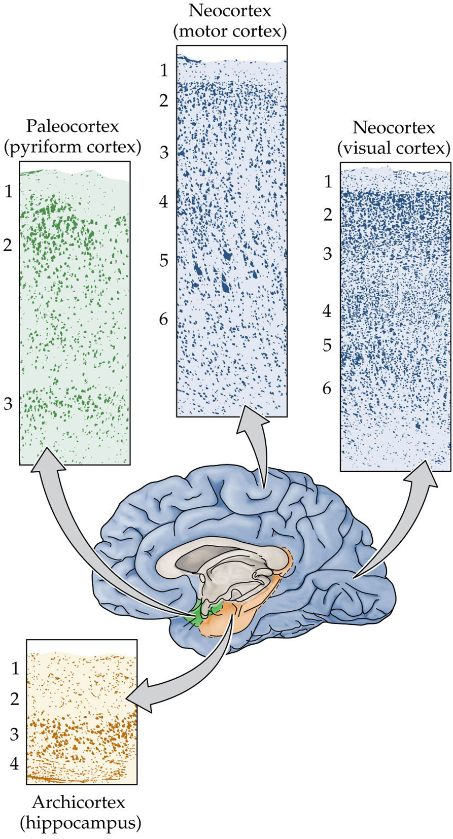
Divisions of Cortex
Neocortex (isocortex) has 6 layers (aka laminae)
  Largest division
Allocortex has less than 6 layers
  archicortex
    4 layers
  paleocortex
    3 layers

Slide 5
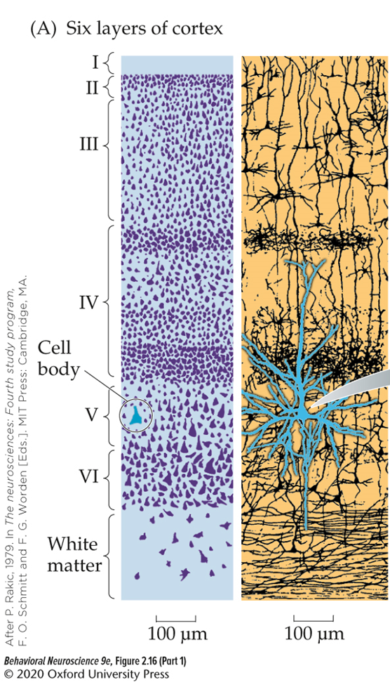
Layers of Neocortex
Neurons of the neocortex are arranged in six layers based on type of neuron and pattern of dendrites or axons.
Layers 1-3 serve mostly integrative functions
Layer 4 takes in sensory information
Layers 5-6 send out information to other brain areas

Slide 6
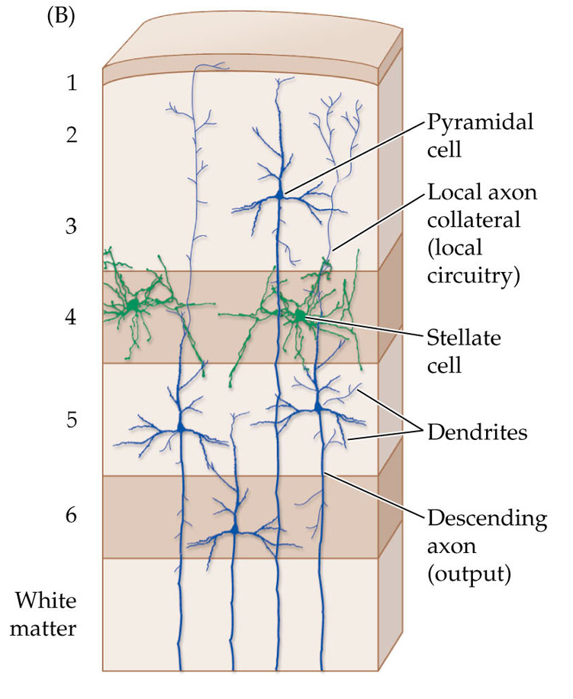
3 basic cell types in the cortex
pyramidal cells (including Betz cells)
  Most layers except 4
stellate cells
  Mostly in layer 4
aspiny interneurons
  Scattered throughout
  Local interconnections

Slide 7
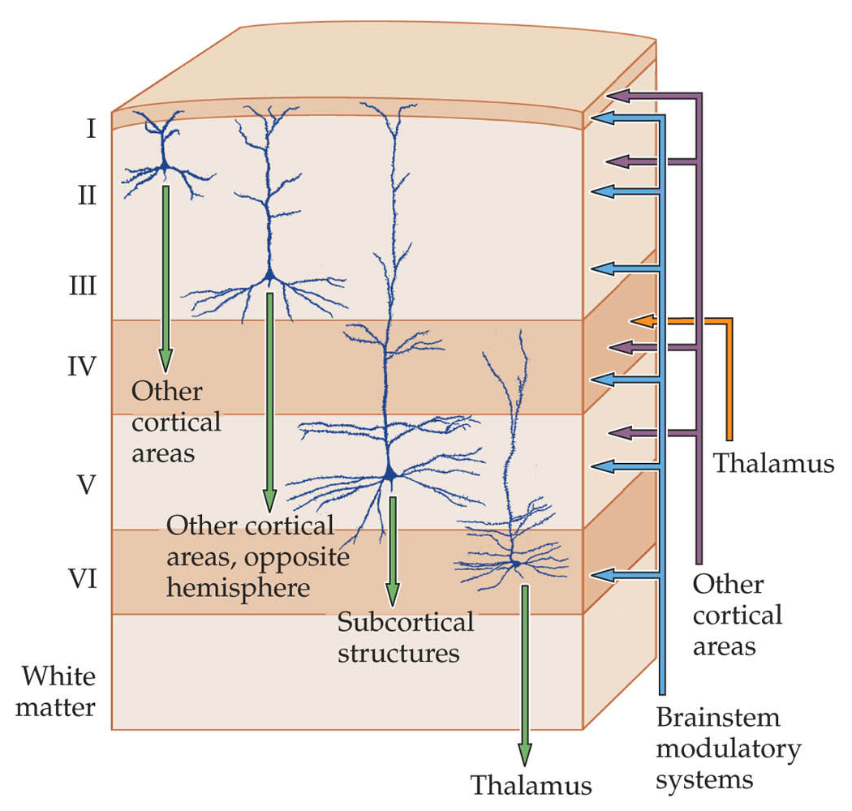
Neocortex Projections
Origin Layer | Target | Target layer(s)
2 & 3 | Cortico-cortical connections | 1, 2, 4, 5 (purple line)
5 | Corticospinal Corticobulbar Corticostriatal | All (blue line)
6 | Corticothalamic | 4 (orange)

Slide 8
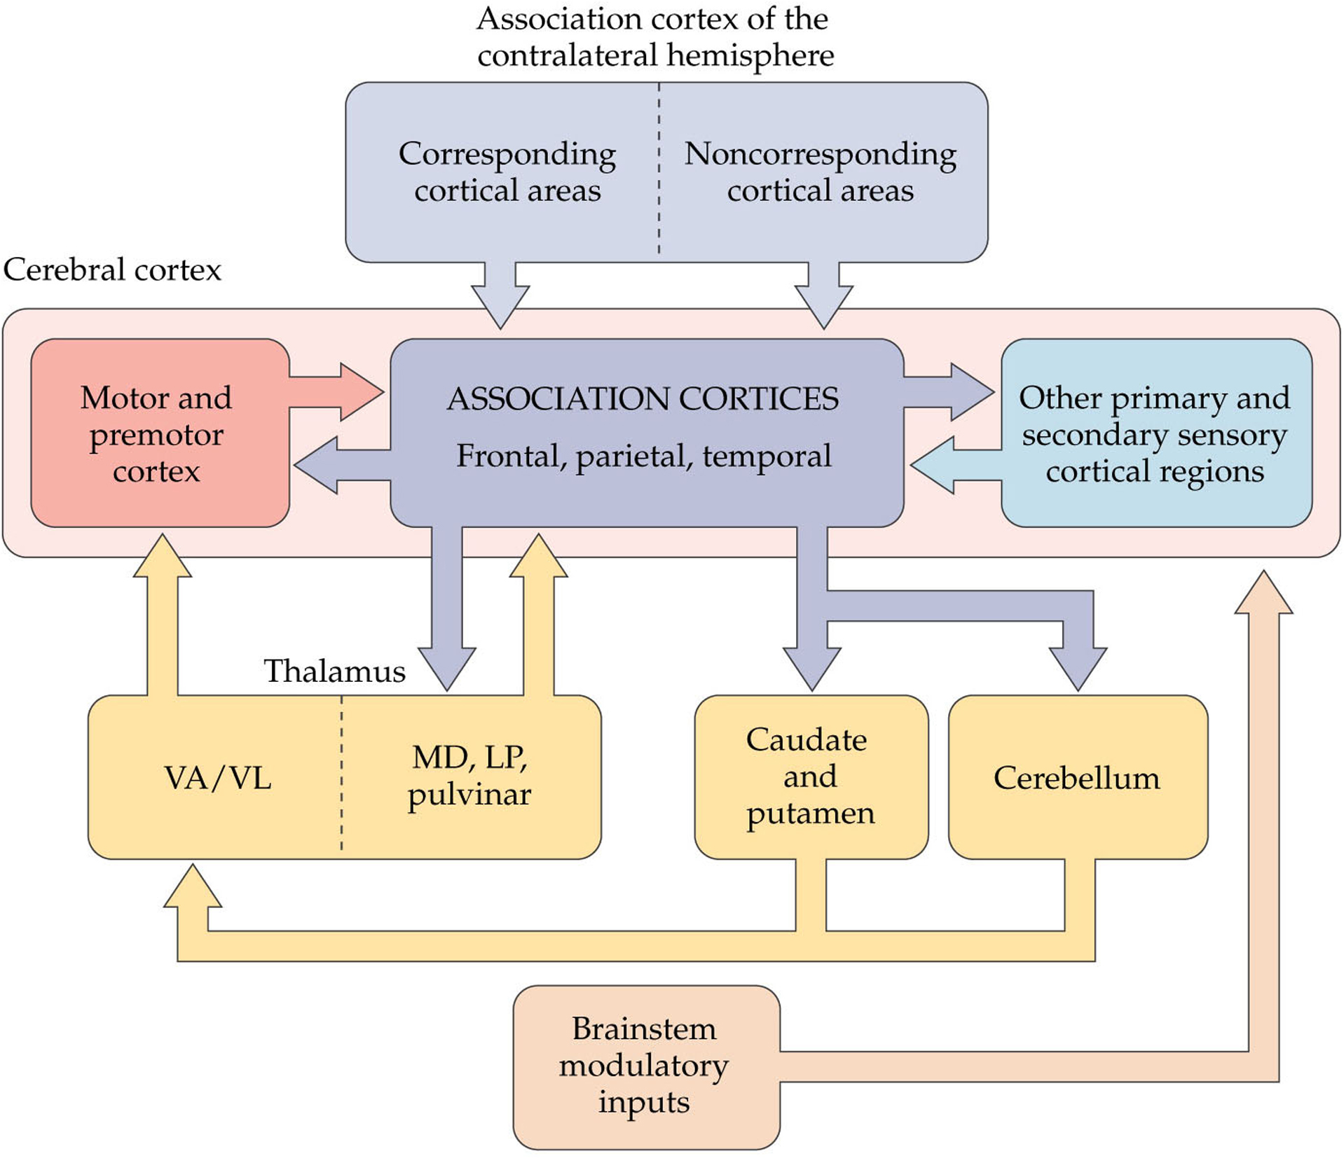
Connectivity of Association Cortices
Most inputs are from other cortical areas
Input from the Thalamus
  Pulvinar → parietal association cortex
  Medial dorsal nuclei → frontal association cortex
Input from subcortical regions
  DA, ACh, 5-ht, and NE hubs

Slide 9
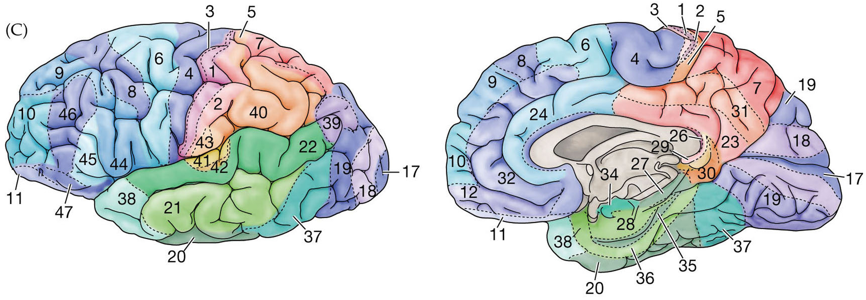
Based on variations in histological features (thickness, cell density, inputs, etc.) of the six neocortical laminae, the human brain can be divided into some 50 cytoarchitectonic (Brodmann) areas

Slide 10
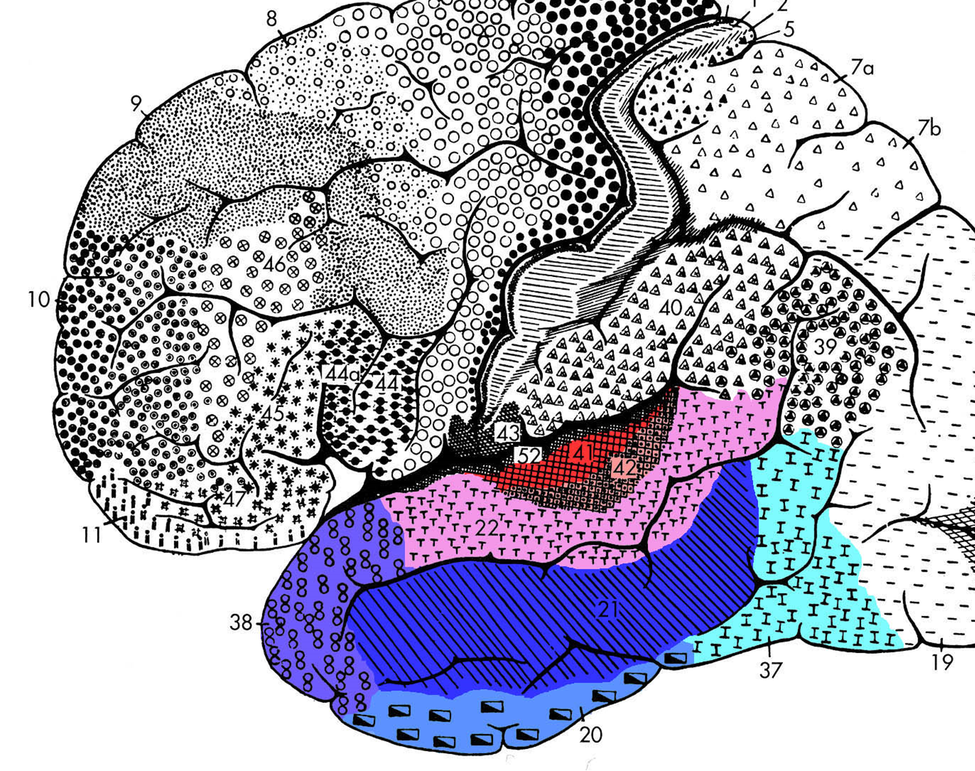
Temporal Cortex

Slide 11
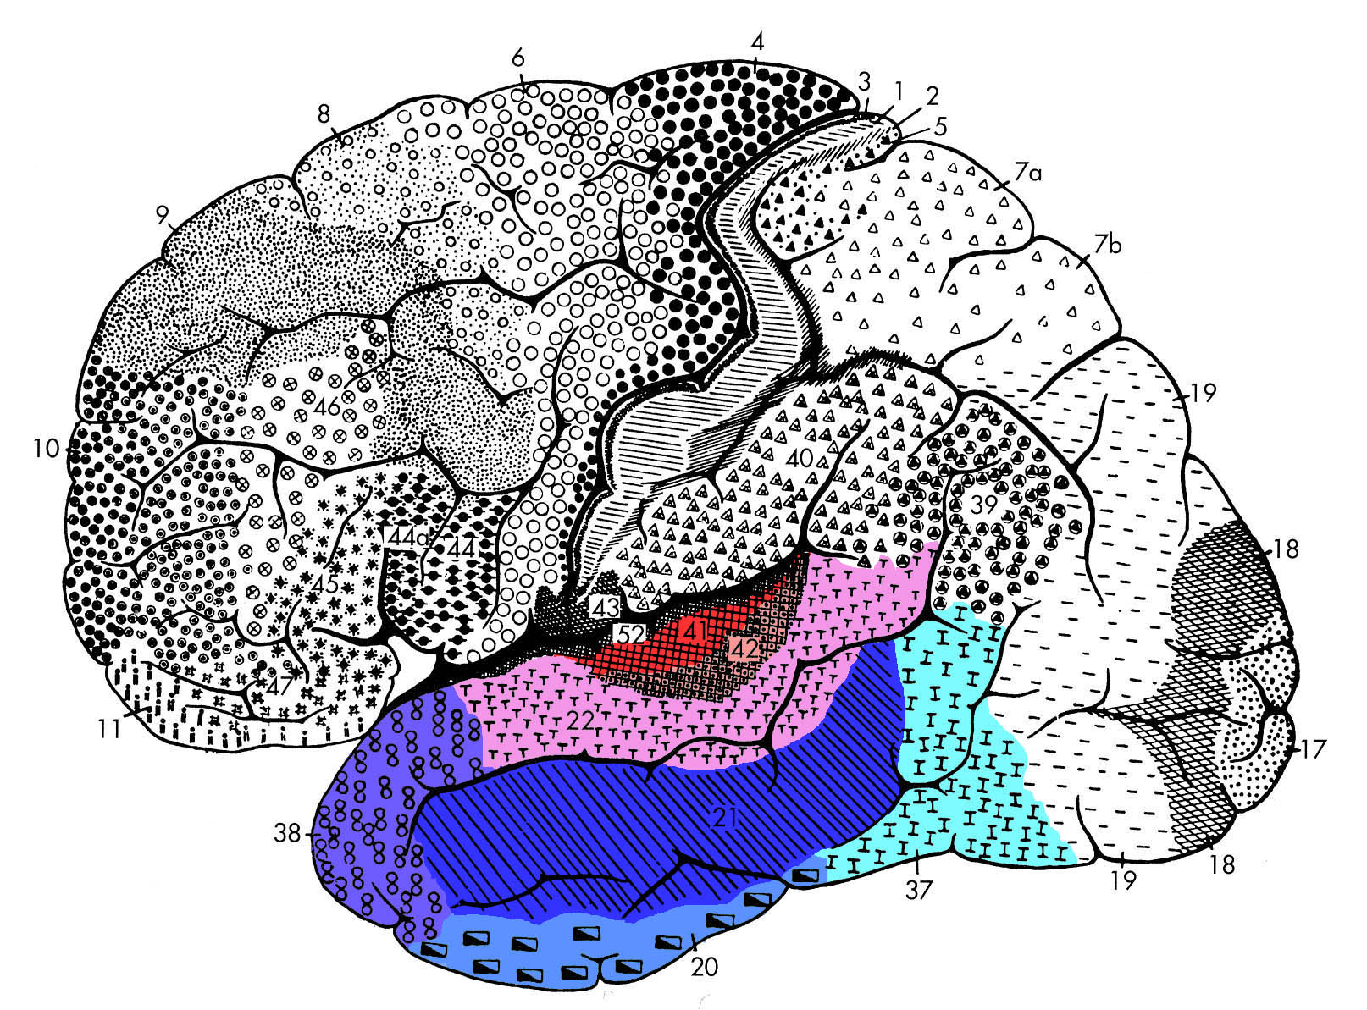
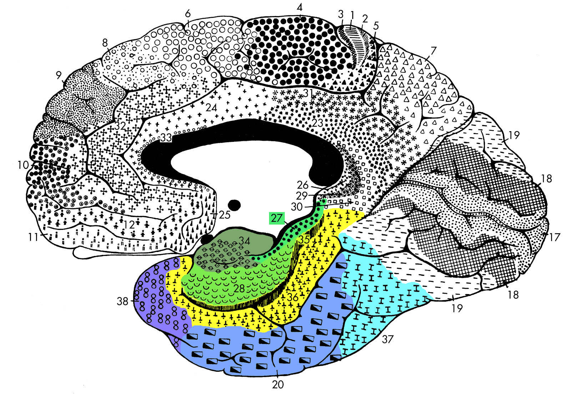
Temporal cortex includes
BA 41,42 & 22
Auditory cortex
BA 20, 21 & 37
Inferior temporal cortex Fusiform gyrus
BA 27, 28 & 34, 35, 36
Medial temporal cortex

Slide 12
Temporal cortex functions
  Primary auditory cortex (BA 41, 42)
  Secondary auditory cortex (BA 22)
Auditory processing
Language processing
Wernicke’s area (BA 22)
Entorhinal cortex (BA 28 & 34)
Perirhinal cortex (BA 35)
Parahippocampal gyrus (BA 36)
Memory

Slide 13
Temporal cortex functions
Visual processing
  Stimulus recognition and categorization
  Ventral visual stream
  Inferior temporal cortex (BA20,21)
  Fusiform gyrus (BA 37)
Multimodal Association Areas
  Temporal pole (BA 38)
  Superior temporal sulcus (STS)

Slide 14
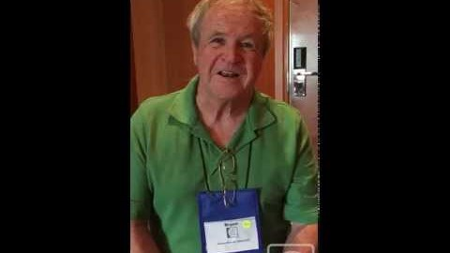
Wernicke’s aphasia
https://www.youtube.com/watch?v=3oef68YabD0

Slide 15
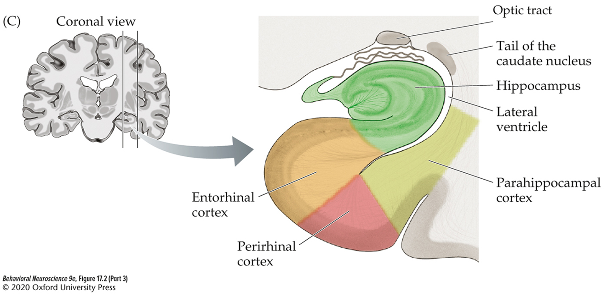
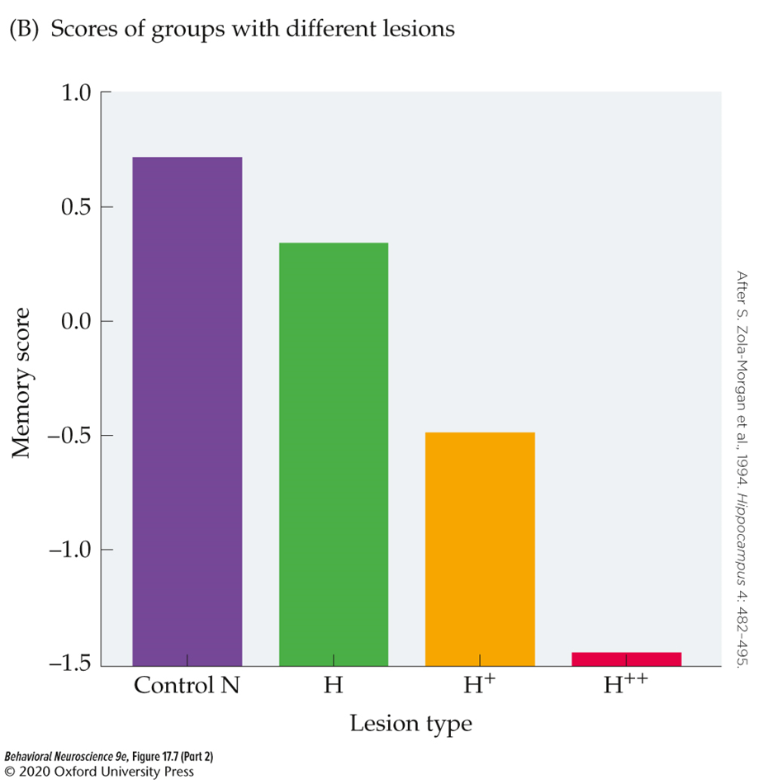
The hippocampus and surrounding cortex are important for declarative Memory formation
Damage to the hippocampus and surrounding cortex (Entorhinal, Perirhinal, and Parahippocampal) results in severe declarative memory impairment.

Slide 16
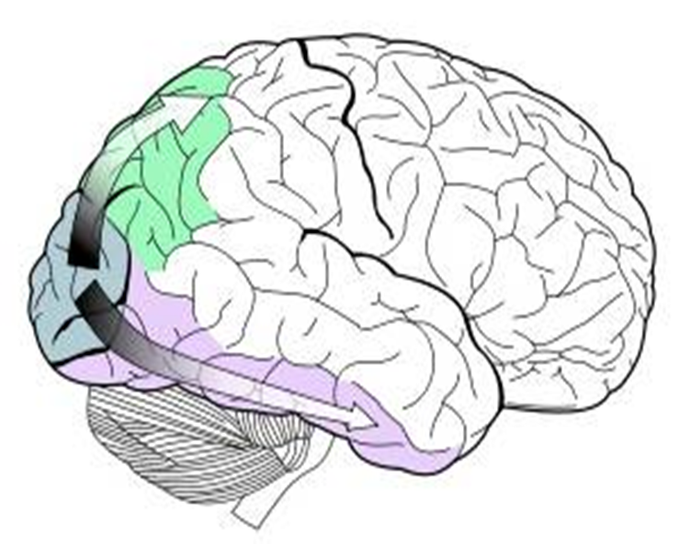

Two streams contribute to Episodic memory formation
Information from the ventral “what” stream passes through perirhinal cortex to entorhinal cortex to hippocampus.
  Binds features of an item
Information from the dorsal “where” stream passes through parahippocampal cortex to entorhinal cortex to hippocampus.
  Binds contextual details
The hippocampus integrates information from both streams to form item in context associations (episodes).

Slide 17
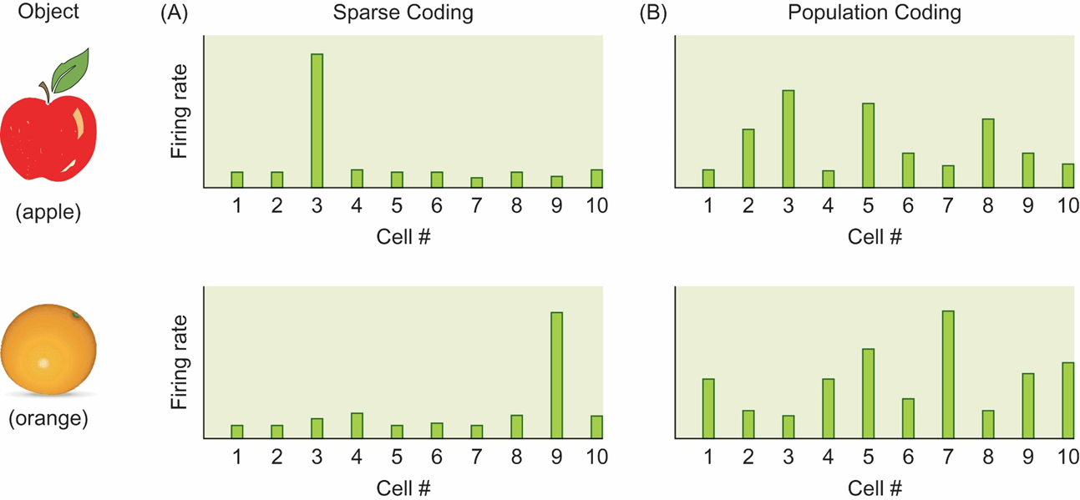
How is a specific object represented within the ventral visual stream?
Sparse coding: theory that a small but specific group of cells responds to the presence of a given object.
Population coding: theory that the pattern of activity across a large population of cells codes for individual objects.

Slide 18
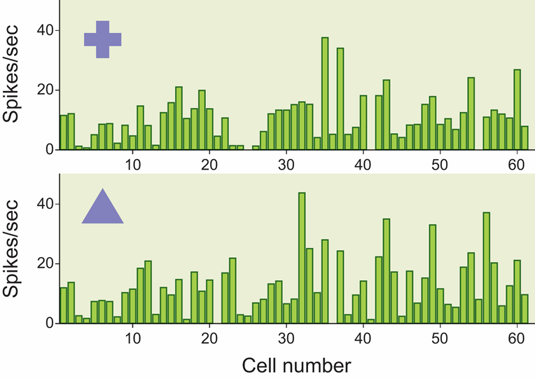

Slide 19
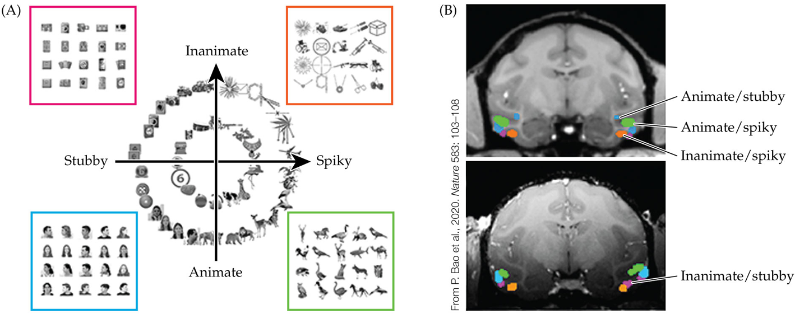

Slide 20
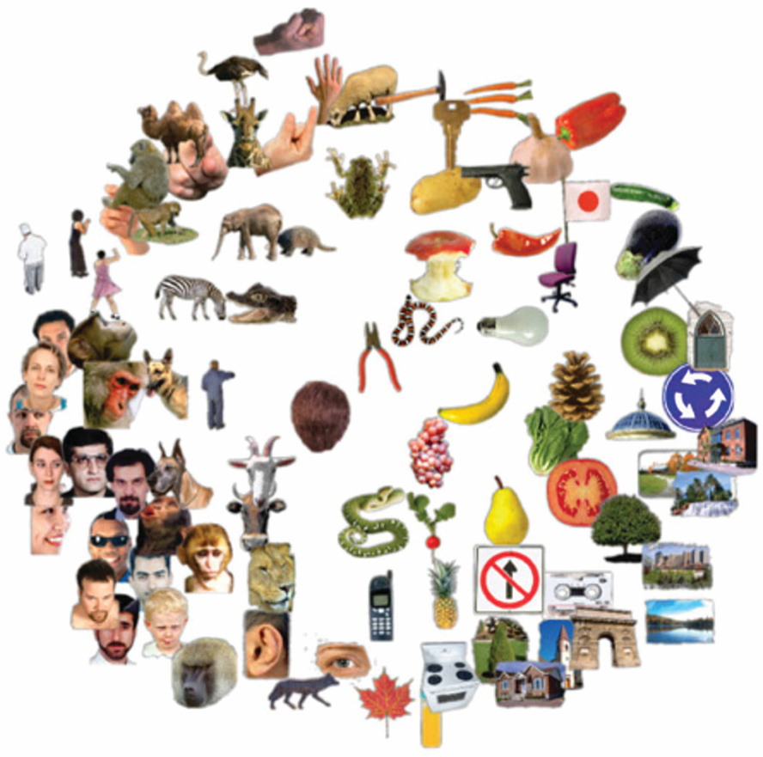
Object categories may be more widely distributed across the ventral stream
Haxby, et al., 2001
Used multi-voxel pattern analysis and machine learning to group stimuli with similar neural responses.
The more similar visual items are, the more similar are their patterns of activity across the brain.

Slide 21
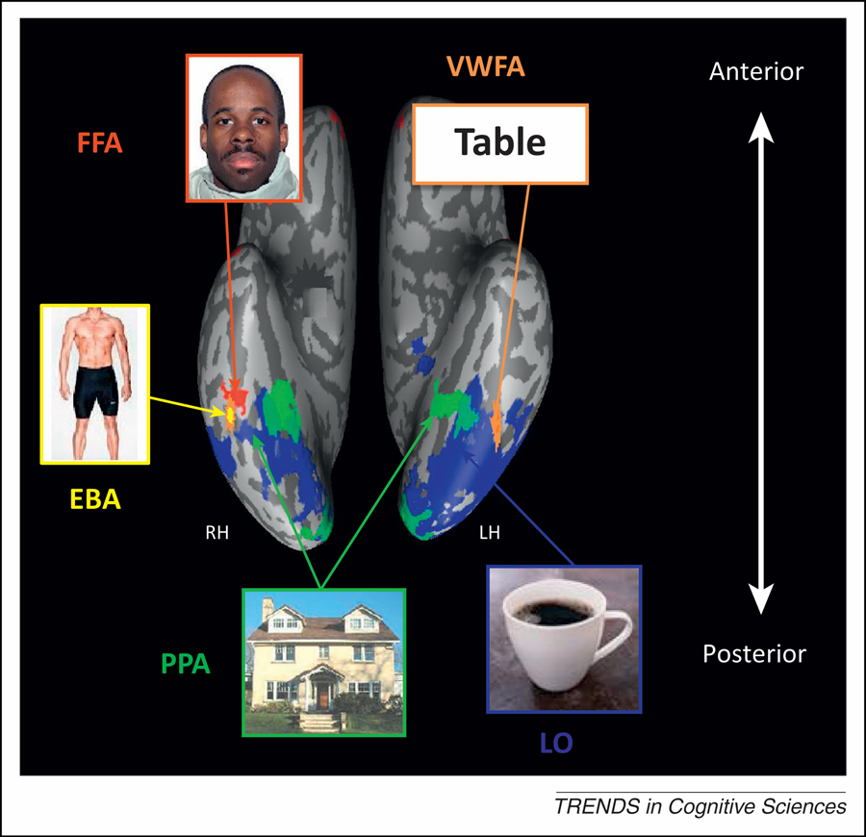
Specialized Areas of the Temporal Lobe for Recognizing Visual Objects
Evidence from fMRI studies show at least some specialized segments including:
  Extrastriate body area (EBA)
  Parahippocampal place area (PPA)
  Visual word form area (VWFA)
  Fusiform face area (FFA)

Slide 22
Agnosias
Inability to recognize objects.
Often linked to temporal lobe damage.
Examples:
  Visual agnosia
  Prosopagnosia

Slide 23
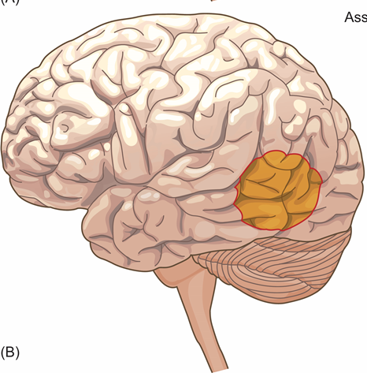
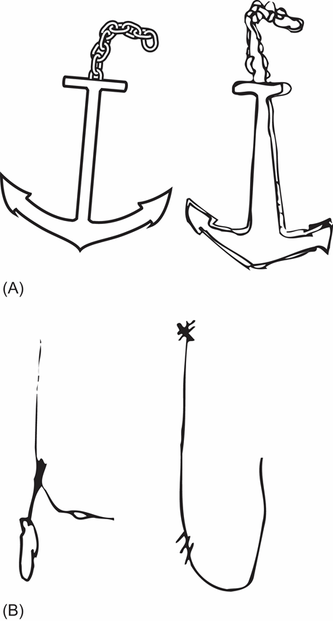
Visual Agnosia
  an inability to recognize objects in the visual modality that cannot be explained by other causes.
    Objects can be recognized using other senses
  damage between occipital and temporal lobe

Slide 24
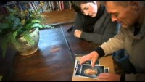
Visual Agnosia Patient
https://www.youtube.com/watch?v=ze8VVtBgK7A

Slide 25
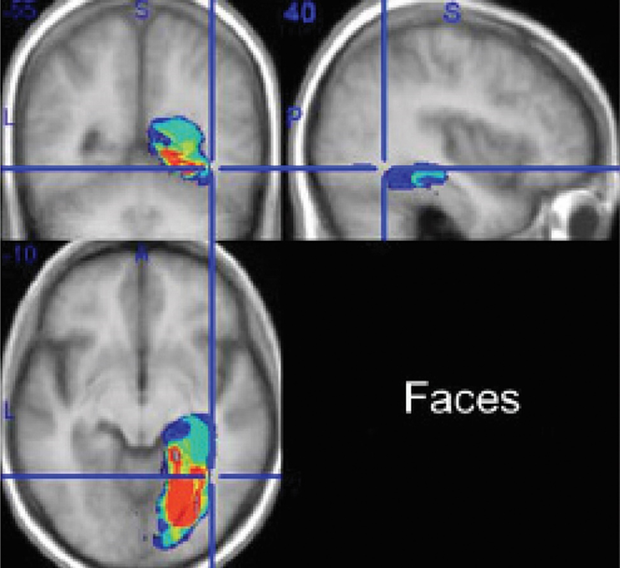
Prosopagnosia
a selective inability to recognize or differentiate among faces.
Damage to the fusiform face area, especially in the right hemisphere

Slide 26

Prosopagnosia Patients
https://www.youtube.com/watch?v=-vQGPcYfIAo

